Slide 1
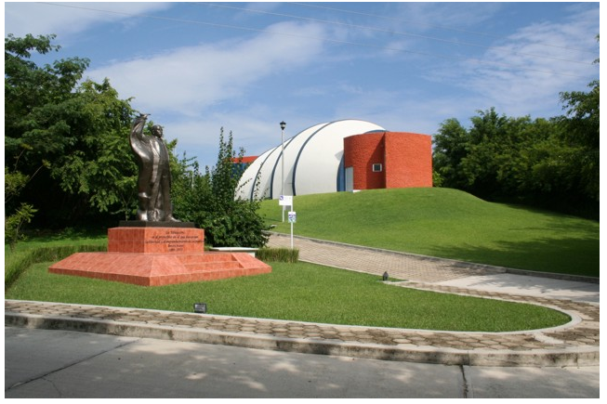
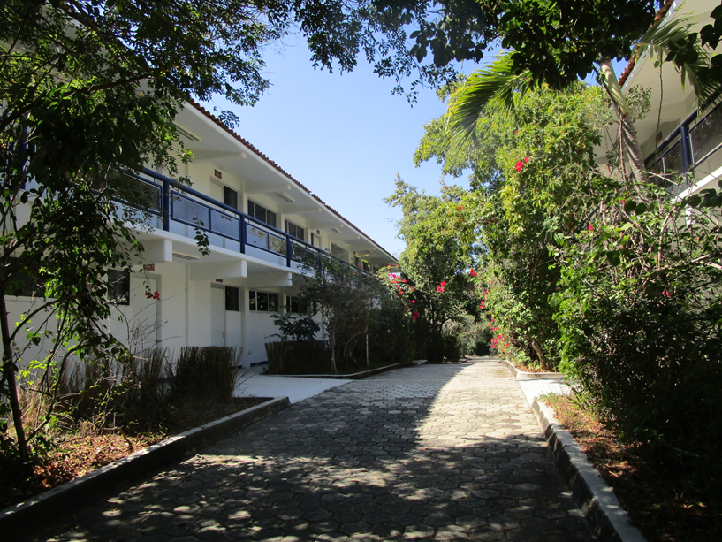
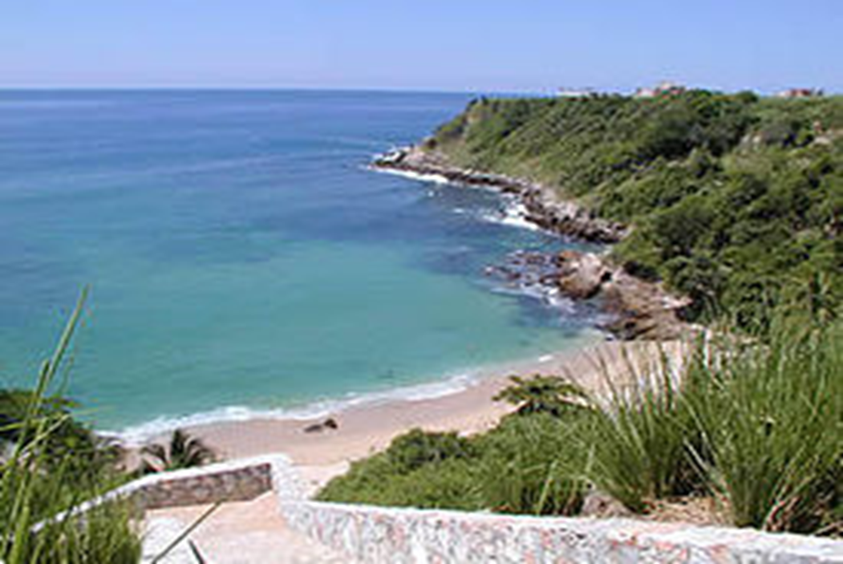

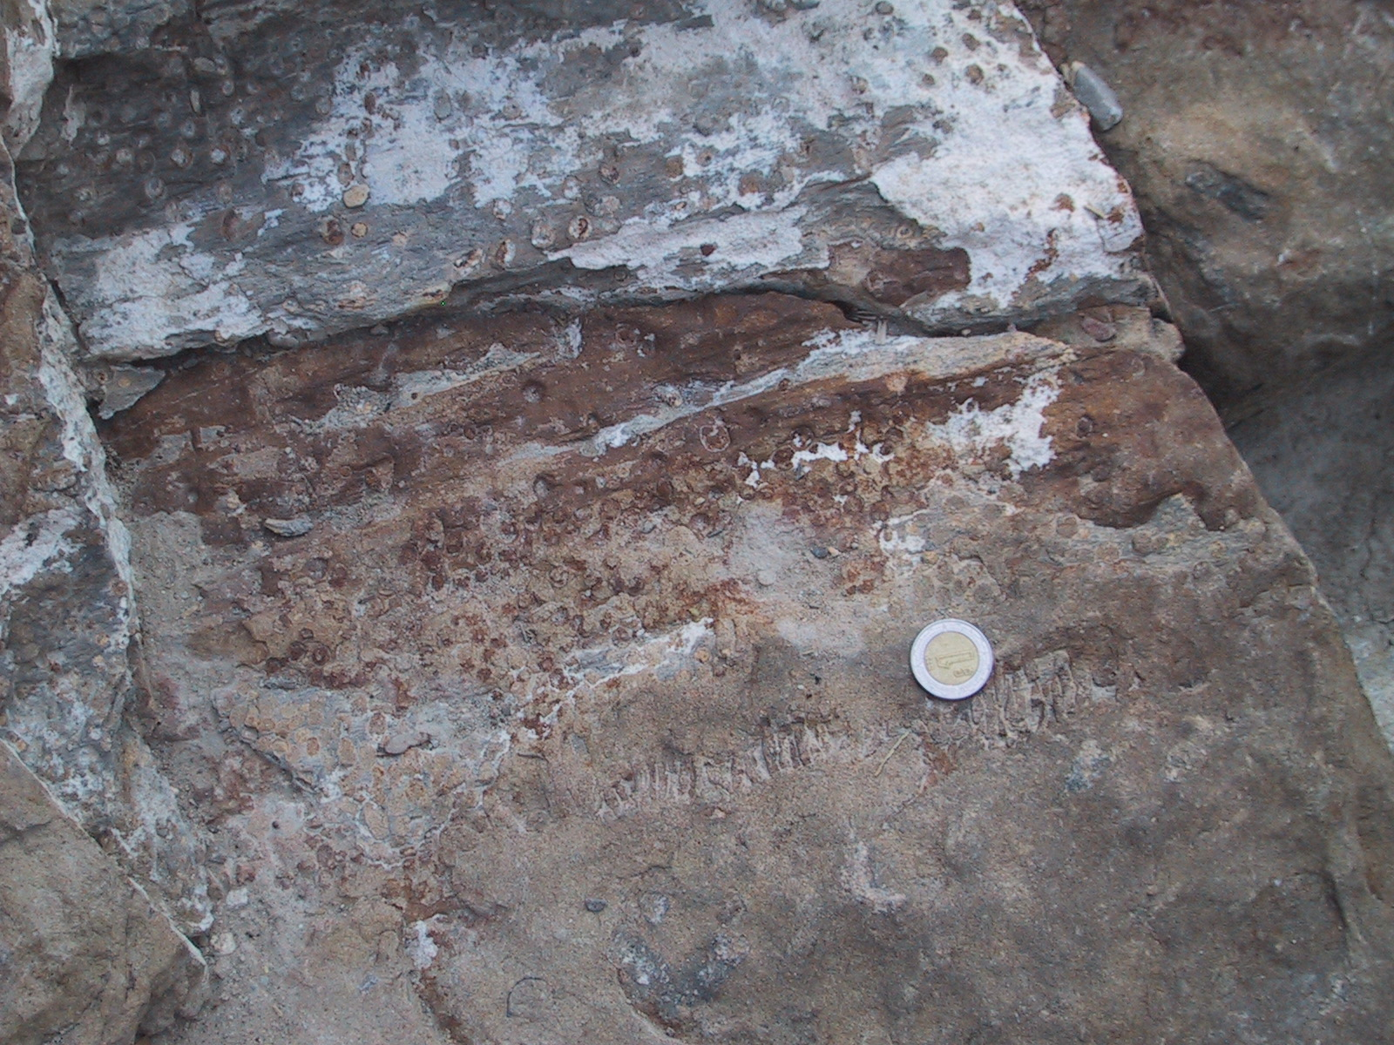
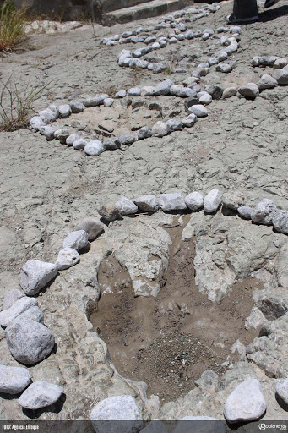
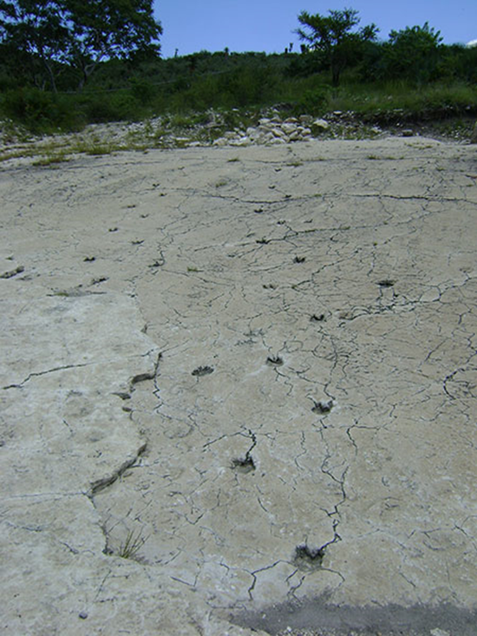
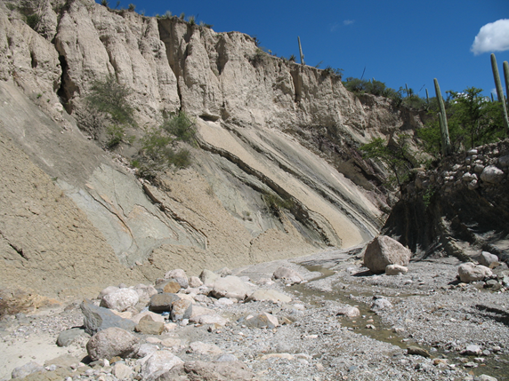


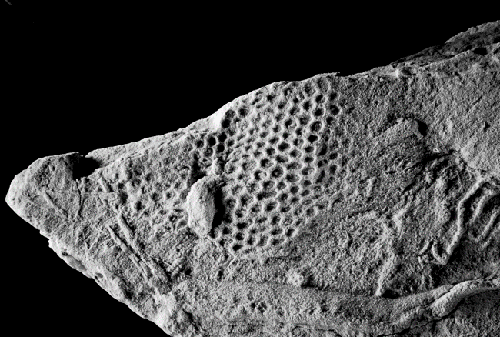






Second Circular
V Simposio Latinoamericano de Icnología
Puerto Escondido, Oaxaca, México. November 21st-24th, 2023
The Lationamerican Symposium of Ichnology (SLIC) represents a traditional event which brings together academics focused on the study and interpretation of the ichnofossils in Latin America and other regions of the world. After to hold this symposium in San Leopoldo, Brazil; Santa Rosa de la Pampa, Argentina; Colonia del Sacramento, Uruguay; and Santa Marta, Colombia, the Universidad del Mar, in Puerto Escondido, Oaxaca, Mexico, is proud to serve as the headquarters of the V SLIC, hoping to achieve the success achieved by the predecessors. With this aim, the Organizing Committee invites all the interested in Ichnology to participate with their attendance at conferences, technical sessions, excursions and all the activities contemplated in our SLIC 2023, sharing their works through oral presentations or posters.
Location
Universidad del Mar, Puerto Escondido, Oaxaca.
Ciudad Universitaria, Carretera Vía Sola de Vega, Puerto Escondido, San Pedro Mixtepec, Juquila, Oax., México, C.P. 71980
Activities
Intra-Symposium Course, November 21st -24th.
Excursions:
i) intra-symposium, November 23rd, COST 35 U. S. DLLS
(ii) post-symposium, November 25th-28th.
Visit to Cretaceous, Paleogene and Neogene localities with records
of the Puebla state. The trip begins at Puerto Escondido, ends at the
Mexico City. COST: 450 U. S. DLLS. , Includes ground transportation, three nights accommodation, three breakfasts, three diners, four lunches.
Universidad del Mar, Puerto Escondido campus
Information about transport, accommodation,
food, scholarships for students,
lecturers, etc. , can be consulted in this link:
https://sites.google.com/ciencias.unam.mx/slic2023/inicio
Local weather information
The average daily temperature hover around 26.5ºC (19ºC to 33ºC) in November and December.
Publication of full papers in a special issue of the Journal of South American Earth Sciences is contemplated
Organizing committee
Francisco Sour-Tovar,1
Rosalía Guerrero-Arenas,2
Sara Alicia Quiroz-Barroso,1
Eduardo Jiménez-Hidalgo,2
1 Facultad de Ciencias, Universidad Nacional Autónoma de México
2 Universidad del Mar, Campus Puerto Escondido, Oaxaca, México
San Juan Raya Formation,
Lower Cretaceous, Zapotitlán, Puebla
Scientific committee
Luis Buatois, Universidad de Saskatchewan, Canadá
Jorge Fernando Genise, Museo Argentino de Ciencias Naturales, BA, Argentina
Eduardo Jiménez, Universidad del Mar, Campus Puerto Escondido, Oaxaca, México
María Gabriela Mangano, Universidad de Saskatchewan, Canadá
Ricardo Néstor Melchor, Universidad de la Pampa, Santa Rosa de la Pampa, Argentina
Renata Netto, UNISINOS, San Leopoldo, Brasil
Mariano Verde, Universidad de la República, Montevideo, Uruguay
Pre-Register: March 1st-May 30th, 2023.
Abstract submissions:
May 1st-July 15th, 2023.
Pie de Vaca Formation, Paleogene?
Tepexi de Rodriguez, Puebla
Fees:
Information
Sara Islas Graciano : sara@ciencias.unam.mx
Deadlines
REGISTER: https://sites.google.com/ciencias.unam.mx/slic2023/registro?authuser=0
Mexcala Formation, Upper Cretaceous, Tecalli, Puebla

